Slide 1

AudioWave: A Microservices-Based Audio Sharing Platform
Design and Implementation of a Full Microservices Architecture
By
Ward Zidani
Ahmad Bsese
Project Code: 24-1-D-44
Software Engineering Department
Braude - College of Engineering, Karmiel
Summer 2024

Slide 2
Problem and Motivation
Problem: There is a growing demand for platforms that allow users to share and listen to audio content efficiently.
Motivation: The need for a scalable and flexible solution that can handle dynamic traffic while providing a seamless audio streaming experience.

Slide 3

System Requirements
Scalability: The system should handle thousands of users simultaneously.
Security: User data must be encrypted and securely managed.
Efficiency: Audio uploads and playback should be fast and responsive.
Modular Design: Each service should be independent, enabling easier maintenance and scalability.
User-friendly Interface: Both content creators and consumers should find the platform easy to use.

Slide 4
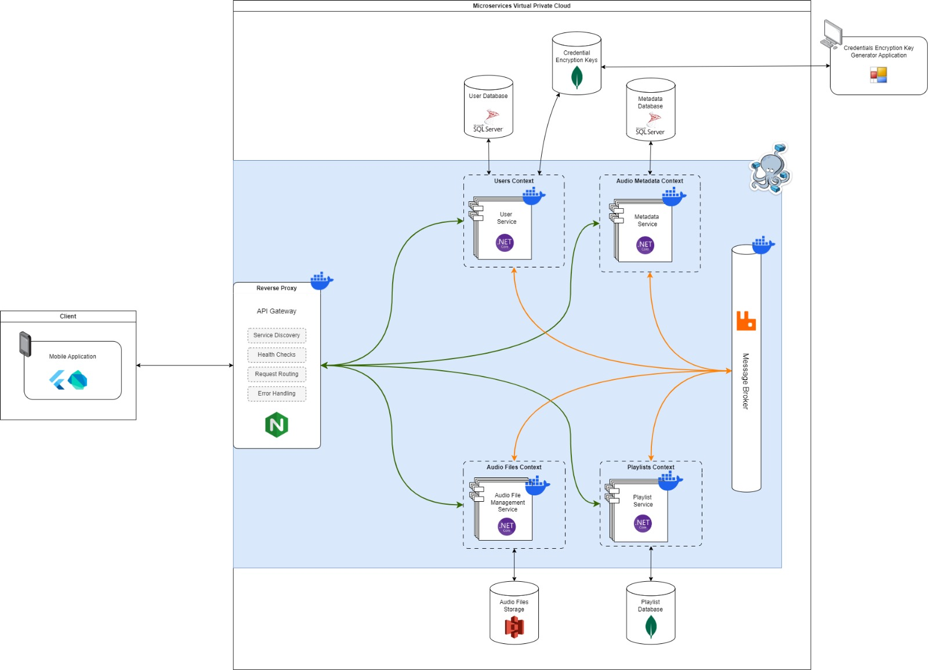
Solution and Technologies
Architecture: The system is built using microservices architecture with Docker containerization
API Gateway: Nginx is used as a reverse proxy to manage incoming requests
Message Broker: RabbitMQ is used for asynchronous communication between microservices
Databases: SQL Server is used for user data and metadata, while MongoDB handles playlists
Frontend: Flutter for the mobile app
Encryption: Credential encryption keys stored in MongoDB

Slide 5

Metrics and Success Criteria
Scalability The system can handle 100,000 users concurrently.
Uptime 99.9% availability due to fault tolerance.
Performance Audio files stream without noticeable delays
Security All sensitive data, such as credentials, are encrypted

Slide 6
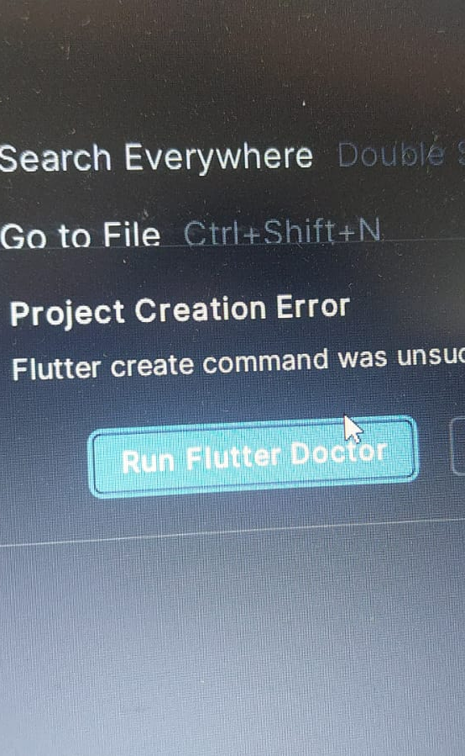
Challenges Faced
Frontend Issues: Error when building the Flutter project in Android Studio; the solution was to open Android Studio as a system administrator.

Slide 7
Challenges Faced
Performance Limitations of Old Laptop
Solution: To mitigate the performance limitations, I sought external support by using IDX from the internet.

Slide 8
Challenges Faced
Docker setup
Archituture complixity

Slide 9
Development Phases and Tools
Planning and Design: Created the system architecture using microservices and defined key functionalities.
Frontend Development: Built the mobile app using Flutter.
Backend Development: Developed the microservices using .NET Core, containerized with Docker.
Testing: Conducted functional and performance tests to ensure system stability.
Tools: GitHub for version control, Docker for containerization, Nginx for routing, RabbitMQ for communication.

Slide 10
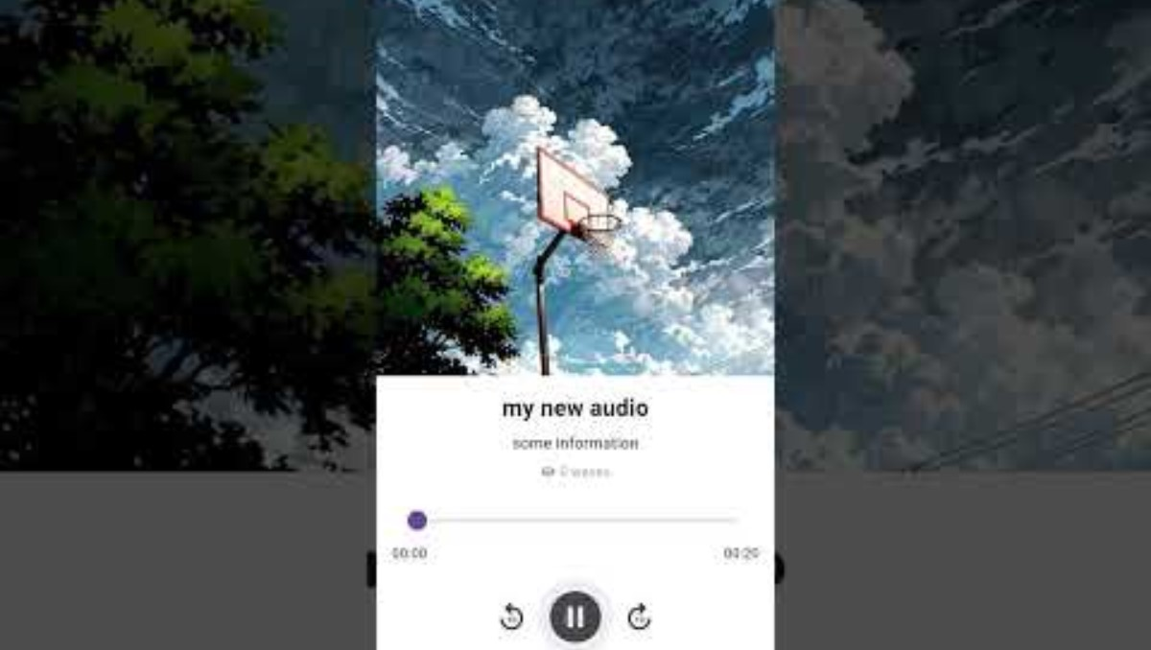

Slide 11
Takeaways and Improvements
What Worked: The microservices architecture allowed us to scale services independently.
What We Would Improve: Optimize caching strategies and better handle frontend build issues earlier in the project.
Key Lesson: Early planning of architecture and communication between services is crucial for system scalability.

Slide 12
Conclusion and Future Development
Project Success: AudioWave successfully meets its goals for scalability, performance, and user experience.
Future Enhancements: Adding more features like advanced search, further optimizing performance, and potentially launching web-based clients in addition to the mobile app.

Slide 13

Thanks for listening

